Slide 1
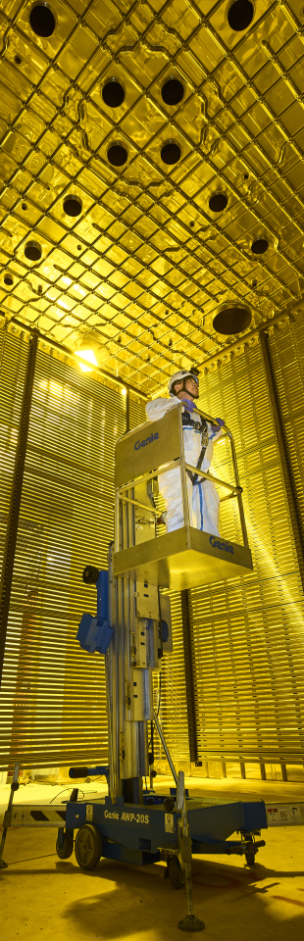

LAR TO GAR AND TRACK RECONSTRUCTION: FUTURE PLANS AND CURRENT STATUS
Presents: Federico Battisti

Slide 2
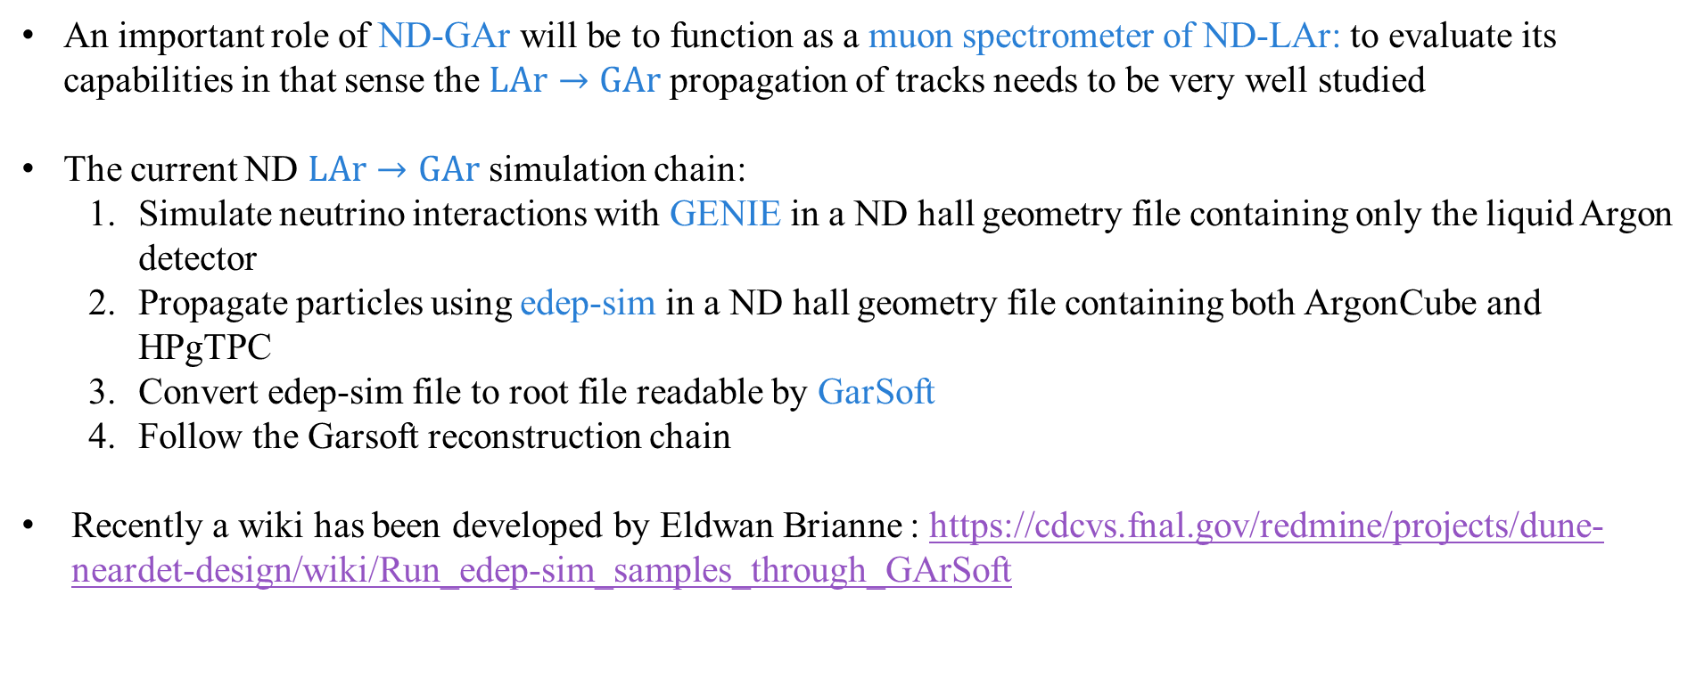
Lar to Gar sample: motivation and current procedure
An important role of ND-GAr will be to function as a muon spectrometer of ND-LAr: to evaluate its capabilities in that sense the $LAr→GAr$ propagation of tracks needs to be very well studied
The current ND $LAr→GAr$ simulation chain:
Simulate neutrino interactions with GENIE in a ND hall geometry file containing only the liquid Argon detector
Propagate particles using edep-sim in a ND hall geometry file containing both ArgonCube and HPgTPC
Convert edep-sim file to root file readable by GarSoft
Follow the Garsoft reconstruction chain
Recently a wiki has been developed by Eldwan Brianne : https://cdcvs.fnal.gov/redmine/projects/dune-neardet-design/wiki/Run_edep-sim_samples_through_GArSoft

Slide 3
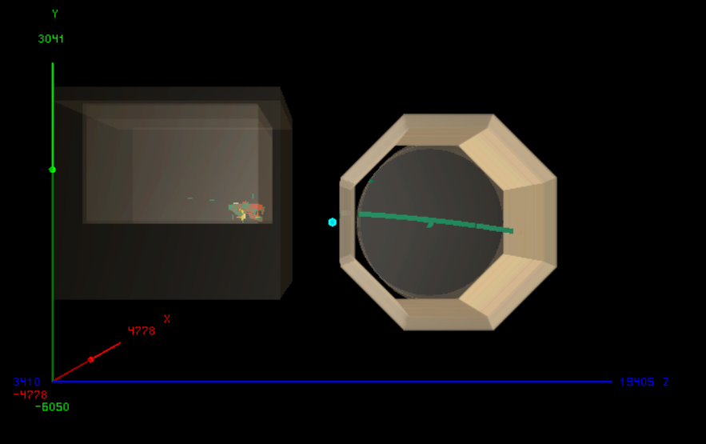
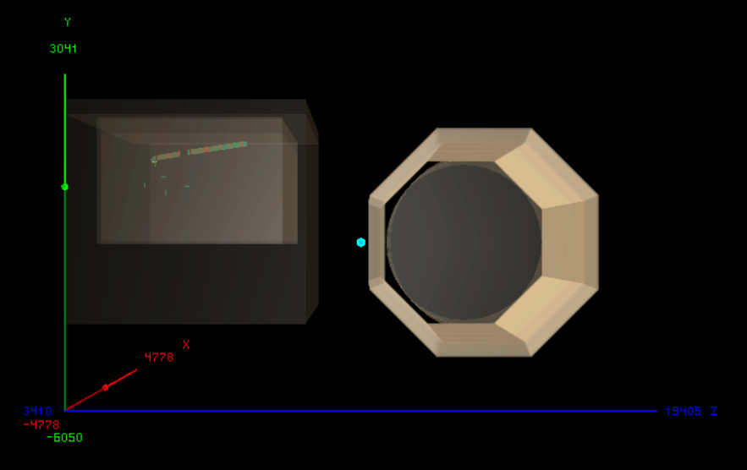
Lar to gar sample: an example
Two examples of $ν_{μ}\left(CC\right)$ interactions in ArgonCube one with a passing muon reaching NDGAr, the other without (both made with edep-disp)
PASSING MUON
NON-PASSING MUON

Slide 4
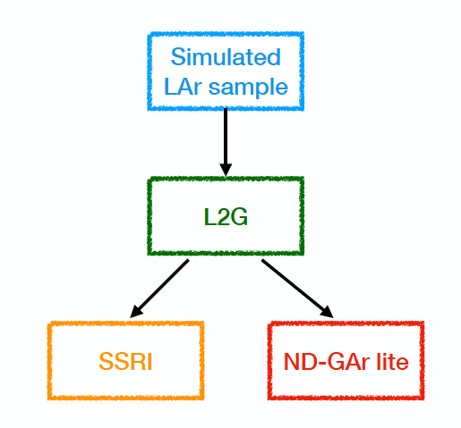
Lar to gar sample: improvements
Strong need for large LAr samples already propagated in edep-sim to test the chain
L2G: interface that takes outgoing LAr particles and feeds them to edep-sim with any TMS detector could speed up the sample production (Currently starting to work on it with Eldwan towards TMS meeting)
Constant B-field currently being used (Custom B-field is already implemented in edep-sim/GArSoft )
Need to improve the track reconstruction and fitting
https://indico.fnal.gov/event/44562/contributions/200915/attachments/136745/170170/DUNE_ND_Meeting_28.10.20.pdf

Slide 5
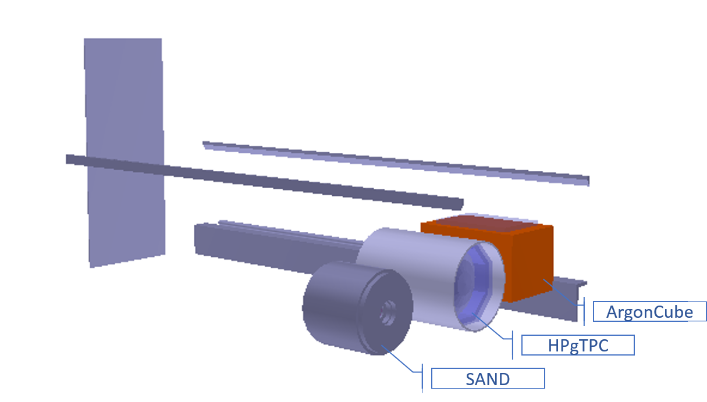
Track finding and fitting in gar
y
Track finding:
Find hits (i.e. pulses found on a single channel)
Group nearby hits in space and time and find their charge centroids found: TPC Clusters
Find track segments (vector hits) and associate them with TPC Clusters
Cluster vector hits together into track candidates
x
z
Track fitting: Kalman filter is applied to the track candidates two times in order to compute the best estimates of the track parameters on both ends of the track (Developed by Thomas Junk and Leo Bellantoni: https://docs.dunescience.org/cgi-bin/private/ShowDocument?docid=13933)

Slide 6


KALMAN FILTER
A Kalman filter is an iterative algorithm which uses a system's physical laws of motion, known control inputs and multiple sequential measurements to form an estimate of the system's varying quantities
At each step of the iteration an estimate of the state of the system is produced as a weighted average of the system's predicted state and of the new measurement. The weights are calculated from the covariance.
The extended Kalman filter expands the Kalman filter technique to non-linear systems
The models for state transition and measurement can be written as:
$$x_{k}=f\left(x_{k−1},u_{k−1}\right)+w_{k−1}$$
$$z_{k}=h\left(x_{k} \right)+v_{k}$$
Where $f$ is the function of the previous state, $x_{k−1}$ , and the control input, $u_{k−1}$, that provides the current state $x_{k}$. $h$ is the measurement function that relates the current state, $x_{k}$, to the measurement $z_{k}$. $w_{k−1}$and $v_{k}$ are Gaussian noises for the process model and the measurement model with covariance 𝑄 and 𝑅, respectively

Slide 7




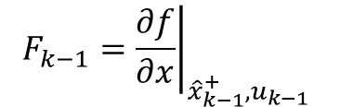
EXTENDED KALMAN FILTER ALGORITHM
Make a priori predictions for the current step’s state and covariance matrix using the a posteriori best estimate of the previous step (i.e. updated using measurement)
STATE VECTOR
$${\hat{x}}_{k}^{−}=f\left({\hat{x}}_{k−1}^{+},u_{k−1}\right)$$
COVARIANCE MATRIX
$$P_{k}^{−}=F_{k−1}P_{k−1}^{+}F_{k−1}^{T}+Q$$
$$F_{k−1}={\left.\frac{∂f}{∂x}\right|}_{{\hat{x}}_{k−1}^{+},u_{k−1}}$$
$$H_{k}={\left.\frac{∂h}{∂x}\right|}_{{\hat{x}}_{k}^{−} }$$
$$Q$$
JACOBIAN
CONVERSION MATRIX
PROCESS NOISE COVARIANCE
Note: In the first iteration step we use step 0 estimates for the state vector and the covariance matrix ($x_{0},P_{0}$), which can be made very roughly

Slide 8





EXTENDED KALMAN FILTER ALGORITHM
Calculate the measurement residual and the Kalman Gain
RESIDUAL
$${\tilde{y}}_{k}=z_{k}−h({\hat{x}}_{k}^{−})$$
$$R$$
KALMAN GAIN
$$K_{k}=P_{k}^{−}H_{k}^{T}{\left(R+H_{k}P_{k}^{−}H_{k}^{T}\right)}^{−1}$$
MEASUREMENT NOISE COVARIANCE
Update the estimate
STATE VECTOR
$${\hat{x}}_{k}^{+}={\hat{x}}_{k}^{−}+K_{k}\tilde{y}$$
COVARIANCE MATRIX
$$P_{k}^{+}=\left(1−K_{k}H_{k}\right)P_{k}^{−}$$

Slide 9
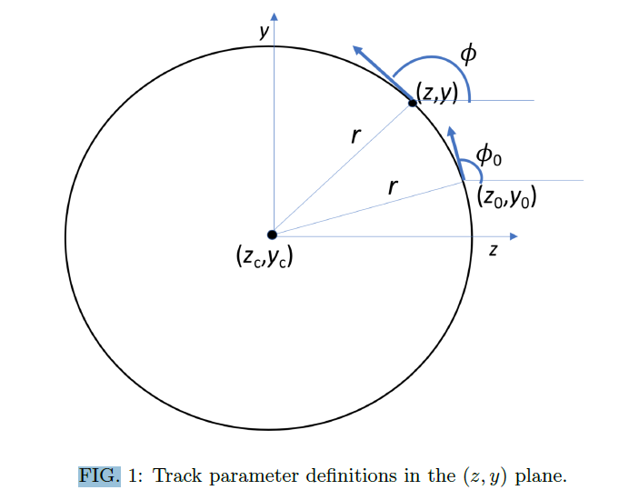
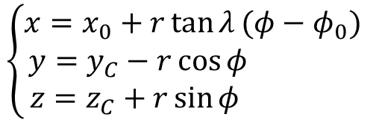
KALMAN FILTER APPLICATION
We want to apply the extended Kalman filter to the motion of a charged particle in the magnetic field
$$\left\{\begin{aligned}x=x_{0}+r\tan{λ}(φ−φ_{0}) \\ &y=y_{C}−r\cos{φ} \\ z=z_{C}+r\sin{φ} \end{aligned}\right.$$
TRACK PARAMETERS
We apply the Kalman filter to track candidates, consisting of groups of TPC clusters, which are identified and put together during the reconstruction process. Each step of the Kalman filter algorithm is identified by one of these TPC clusters
T. Junk, DUNE-Doc-13933
https://docs.dunescience.org/cgi-bin/private/ShowDocument?docid=13933

Slide 10
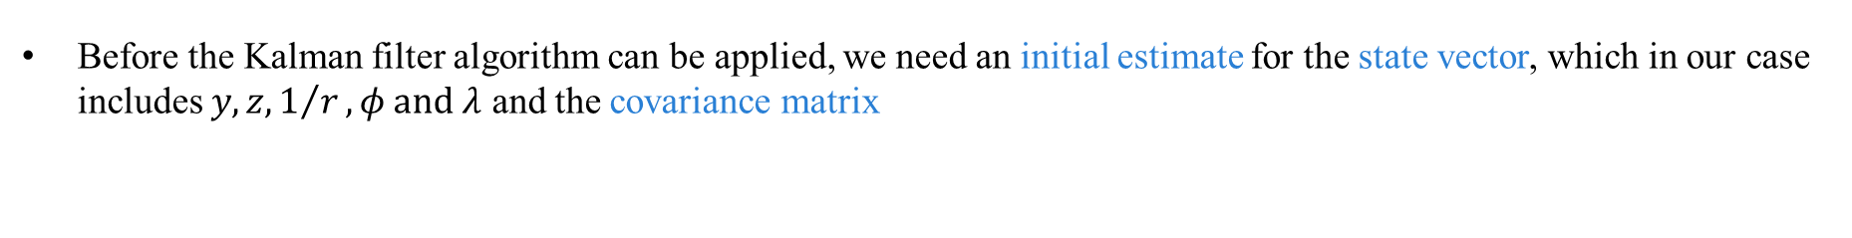
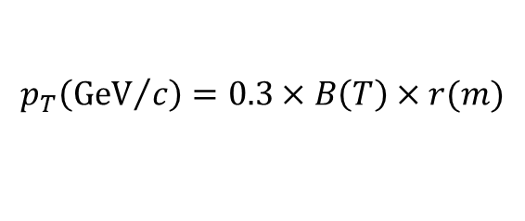


KALMAN FILTER APPLICATION: initial estimates
Before the Kalman filter algorithm can be applied, we need an initial estimate for the state vector, which in our case includes $y,z,1/r,φ and λ$ and the covariance matrix
STATE VECTOR
$$x_{0}^{T}=\begin{matrix}(y_{0} & z_{0} & 1/r_{0}\end{matrix} \begin{matrix}φ_{0} & λ_{0}\end{matrix})=\left(\begin{matrix}0 & 0 & 0.1\end{matrix} \begin{matrix}0 & 0\end{matrix}\right)$$
$$P_{0}=\left(\begin{matrix}1^{2} & 0 & 0 \\ 0 & 1^{2} & 0 \\ \begin{aligned}0 \\ 0 \\ 0\end{aligned} & \begin{aligned}0 \\ 0 \\ 0\end{aligned} & \begin{aligned}{0.5}^{2} \\ 0 \\ 0\end{aligned}\end{matrix} \begin{matrix}0 \\ 0 \\ \begin{aligned}0 \\ {0.5}^{2} \\ 0\end{aligned}\end{matrix} \begin{matrix}0 \\ 0 \\ \begin{aligned}0 \\ 0 \\ {0.5}^{2}\end{aligned}\end{matrix}\right)$$
COVARIANCE MATRIX
The estimated quantities from the state vector can be used to estimate the particle’s momentum
$$\left\{\begin{aligned}p_{x}=p_{T}\tan{λ} \\ p_{y}=p_{T}\sin{φ} \\ p_{z}=p_{T}\cos{φ}\end{aligned}\right.$$
$$p_{T}\left({GeV}/c\right)=0.3×B\left(T\right)×r(m)$$

Slide 11
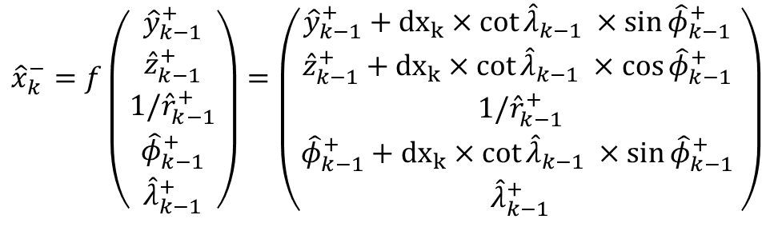
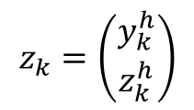
KALMAN FILTER APPLICATION: prediction AND MEASUREMENT
From the equation of motion we obtain the prediction function for our state vector.
$${\hat{x}}_{k}^{−}=f\left({{\hat{y}}_{k−1}^{+} \atop \begin{aligned}{\hat{z}}_{k−1}^{+} \\ {1/\hat{r}}_{k−1}^{+} \\ {\hat{φ}}_{k−1}^{+} \\ {\hat{λ}}_{k−1}^{+}\end{aligned}}\right)=\left({{\hat{y}}_{k−1}^{+}+{dx}_{k}×cot{{\hat{λ}}_{k−1} ×\sin{{\hat{φ}}_{k−1}^{+} }} \atop \begin{aligned}{\hat{z}}_{k−1}^{+}+{dx}_{k}×cot{{\hat{λ}}_{k−1} ×\cos{{\hat{φ}}_{k−1}^{+} }} \\ {1/\hat{r}}_{k−1}^{+} \\ {\hat{φ}}_{k−1}^{+}+{dx}_{k}×cot{{\hat{λ}}_{k−1} ×\sin{{\hat{φ}}_{k−1}^{+} }} \\ {\hat{λ}}_{k−1}^{+}\end{aligned}}\right)$$
Note: the prediction model does not account for dE/dx energy loss
The only measured quantities in our case are $y$ and $z$, and are set at the center of the TPC cluster correspondent to the present step.
$$z_{k}=\left({y_{k}^{h} \atop z_{k}^{h}}\right)$$

Slide 12
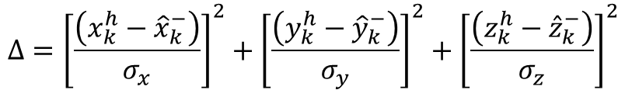
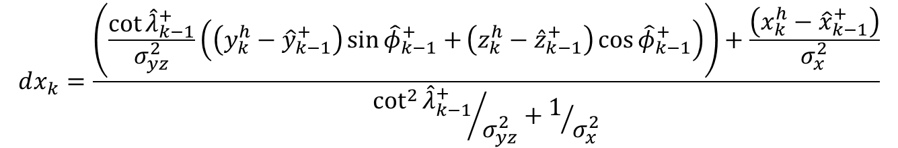
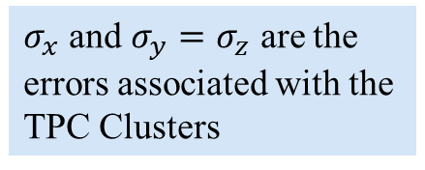
KALMAN FILTER APPLICATION: STEP DEtermination
Each algorithm step corresponds to a TPC cluster. The x coordinate is treated as independent and used to identify the step width $dx$. The step width is determined for each algorithm step, so that it minimizes:
$$Δ={\left[\frac{\left(x_{k}^{h}−{\hat{x}}_{k}^{−}\right)}{σ_{x}}\right]}^{2}+{\left[\frac{\left(y_{k}^{h}−{\hat{y}}_{k}^{−}\right)}{σ_{y}}\right]}^{2}+{\left[\frac{\left(z_{k}^{h}−{\hat{z}}_{k}^{−}\right)}{σ_{z}}\right]}^{2}$$
$σ_{x}$ and $σ_{y}=σ_{z}$ are the errors associated with the TPC Clusters
For each step we then have:
Note: despite being our free parameter, x is associated with an uncertainty; other options might be worth exploring
$$dx_{k}=\frac{\left(\frac{\cot{{\hat{λ}}_{k−1}^{+}}}{σ_{yz}^{2}}\left(\left(y_{k}^{h}−{\hat{y}}_{k−1}^{+}\right)\sin{{\hat{φ}}_{k−1}^{+}+}\left(z_{k}^{h}−{\hat{z}}_{k−1}^{+}\right)\cos{{\hat{φ}}_{k−1}^{+}}\right)\right)+\frac{\left(x_{k}^{h}−{\hat{x}}_{k−1}^{+}\right)}{σ_{x}^{2}}}{{\cot^{2}{{\hat{λ}}_{k−1}^{+}}}/{σ_{yz}^{2}}+1/{σ_{x}^{2}}}$$

Slide 13
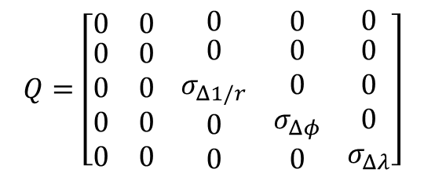
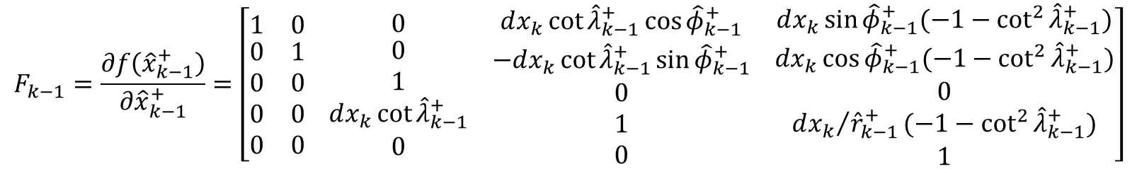

KALMAN FILTER APPLICATION: COVARIANCE MATRIX PREDICTION
First step to make the prediction for the covariance matrix is to calculate the Jacobian
$$F_{k−1}=\frac{∂f\left({\hat{x}}_{k−1}^{+}\right)}{∂{\hat{x}}_{k−1}^{+}}=\left[\begin{matrix}1 & 0 \\ \begin{aligned}0 \\ 0 \\ 0 \\ 0\end{aligned} & \begin{aligned}1 \\ 0 \\ 0 \\ 0\end{aligned}\end{matrix} \begin{matrix}0 \\ \begin{aligned}0 \\ 1 \\ dx_{k}\cot{{\hat{λ}}_{k−1}^{+}} \\ 0\end{aligned}\end{matrix} \begin{matrix}dx_{k}\cot{{\hat{λ}}_{k−1}^{+}\cos{{\hat{φ}}_{k−1}^{+}}} \\ \begin{aligned}−dx_{k}\cot{{\hat{λ}}_{k−1}^{+}\sin{{\hat{φ}}_{k−1}^{+}}} \\ 0 \\ 1 \\ 0\end{aligned}\end{matrix} \begin{matrix}dx_{k}\sin{{\hat{φ}}_{k−1}^{+}(−1−\cot^{2}{{\hat{λ}}_{k−1}^{+}})} \\ \begin{aligned}dx_{k}\cos{{\hat{φ}}_{k−1}^{+}(−1−\cot^{2}{{\hat{λ}}_{k−1}^{+}})} \\ 0 \\ {dx_{k}}/{{\hat{r}}_{k−1}^{+}}(−1−\cot^{2}{{\hat{λ}}_{k−1}^{+}}) \\ 1\end{aligned}\end{matrix}\right]$$
The step uncertainty matrix is also needed
$$Q=\left[\begin{matrix}0 & 0 \\ \begin{aligned}0 \\ 0 \\ 0 \\ 0\end{aligned} & \begin{aligned}0 \\ 0 \\ 0 \\ 0\end{aligned}\end{matrix} \begin{matrix}0 \\ \begin{aligned}0 \\ σ_{Δ1/r} \\ 0 \\ 0\end{aligned}\end{matrix} \begin{matrix}0 \\ \begin{aligned}0 \\ 0 \\ σ_{Δφ} \\ 0\end{aligned}\end{matrix} \begin{matrix}0 \\ \begin{aligned}0 \\ 0 \\ 0 \\ σ_{Δλ}\end{aligned}\end{matrix}\right]$$
The prediction is then:
$$P_{k}^{−}=F_{k−1}P_{k−1}F_{k−1}^{T}+Q$$

Slide 14

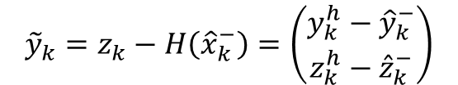


KALMAN FILTER APPLICATION: Evaluate the residual
We now evaluate the residual and Kalman Gain
RESIDUAL
With:
$${\tilde{y}}_{k}=z_{k}−H\left({\hat{x}}_{k}^{−}\right)=\left(\begin{matrix}y_{k}^{h}−{\hat{y}}_{k}^{−} \\ z_{k}^{h}−{\hat{z}}_{k}^{−}\end{matrix}\right)$$
$$R=\left(\begin{matrix}σ_{yz}^{2} & 0 \\ 0 & σ_{yz}^{2}\end{matrix}\right)$$
MEASUREMENT NOISE COVARIANCE
KALMAN GAIN
$$H=\left(\begin{matrix}1 & 0 & 0 \\ 0 & 1 & 0\end{matrix} \begin{matrix}0 \\ 0\end{matrix} \begin{matrix}0 \\ 0\end{matrix}\right)$$
$$K_{k}=P_{k}^{−}H{\left(R+HP_{k}^{−}H^{T}\right)}^{−1}$$
CONVERSION MATRIX
Note: The uncertainties in R are fixed, before the Kalman filter is applied, as external parameters: R is not updated.

Slide 15
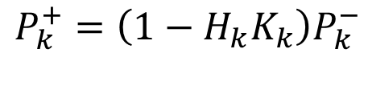

KALMAN FILTER APPLICATION: PREDICTION UPDATE
We are now finally able to update our estimates using both the a priori prediction and the measurement
STATE VECTOR
$${\hat{x}}_{k}^{+}={\hat{x}}_{k}^{−}+K_{k}{\tilde{y}}_{k}$$
COVARIANCE MATRIX
$$P_{k}^{+}=\left(1−H_{k}K_{k}\right)P_{k}^{−}$$

Slide 16

KALMAN FILTER APPLICATION:$Χ^{2}$
The Kalman filter algorithm is applied to the track candidate both ways (i.e. From first TPC cluster to last and vice versa) and each time a $χ^{2}$ value is calculated
$$χ^{2}=\frac{\sum{{\left|{\tilde{y}}_{k}\right|}^{2}}}{\sum{{\left|y_{k}^{typ}\right|}^{2}}}$$
Where $y_{k}^{typ}$ is the residual typical value which depends on the particle trajectory position in the detector and the tracking planes (fixed values evaluated a priori)

Slide 17
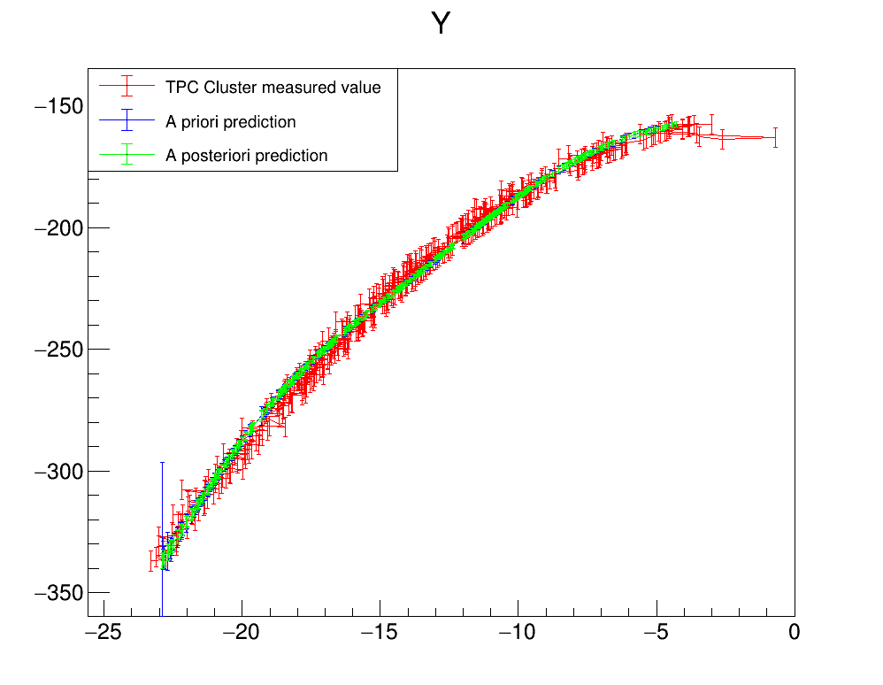
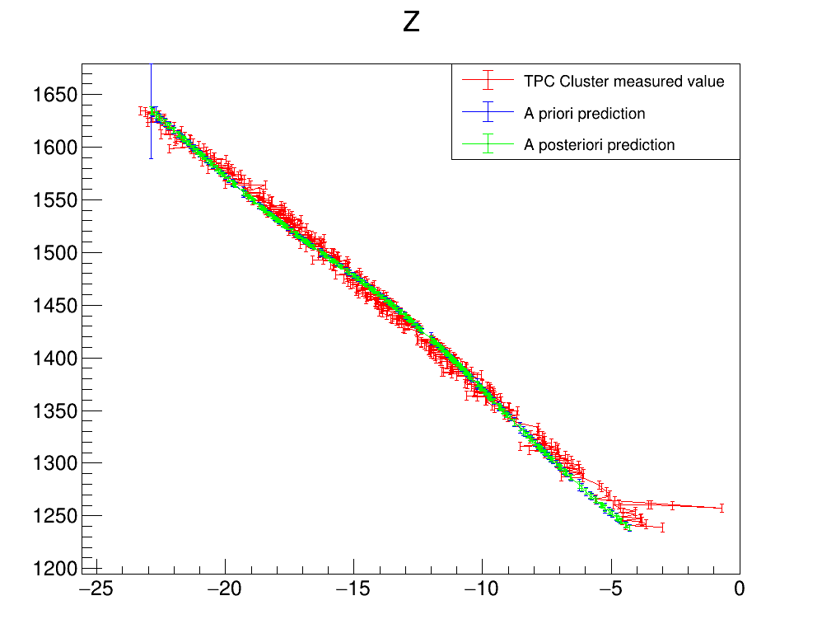
KALMAN FILTER: PERFORMANCE evaluation
Plots describing the evolution of the estimate for the measured quantities $(y,z)$ as a function of the free parameter $x$ (Information retrieved directly modifying the kalman filter module in garsoft tpctrackfit2_module.cc) for a muon from a particle gun pointing towards the center of the TPC. FORWARD FIT
FITTER PROPAGATION DIRECTION
Note: the energy loss (dE/dx) of the particle along the track causes the particle to slow down and the track parameters (i.e the curvature) to change. The Kalman filter updates step by step its estimates using measurement and taking into account these changes: for this reason the Forward and Backward fits will produce different results, despite being performed with the same procedure

Slide 18
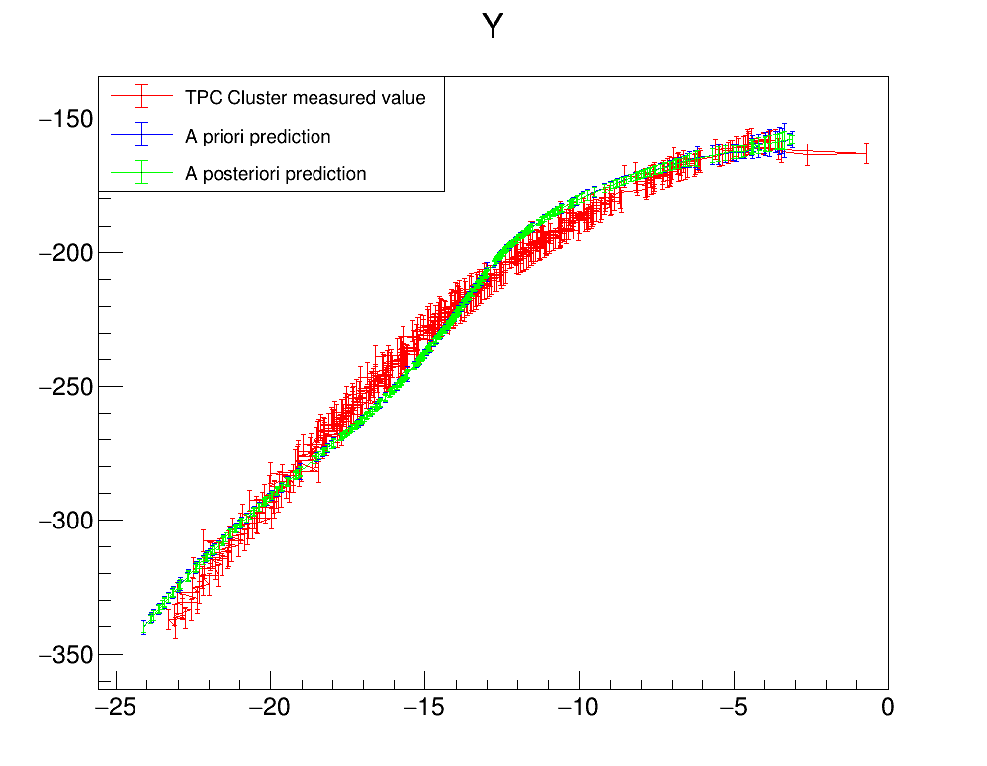
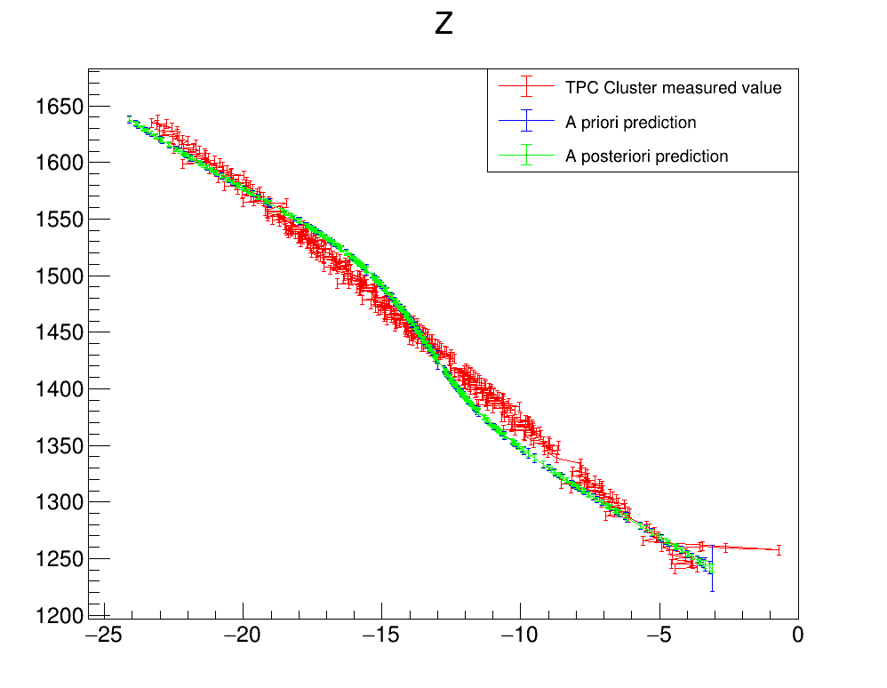
KALMAN FILTER: PERFORMANCE evaluation
Plots describing the evolution of the estimate of the measured quantities $(y,z)$ as a function of the free parameter $x$ (Information retrieved directly modifying the kalman filter module in garsoft tpctrackfit2_module.cc) for a muon from a particle gun pointing towards the center of the TPC: BACKWARD FIT
FITTER PROPAGATION DIRECTION
Note: at the moment the Kalman gain is calibrated in such a way to strongly favour the a priori prediction over the measurement; this might not be the ideal choice

Slide 19
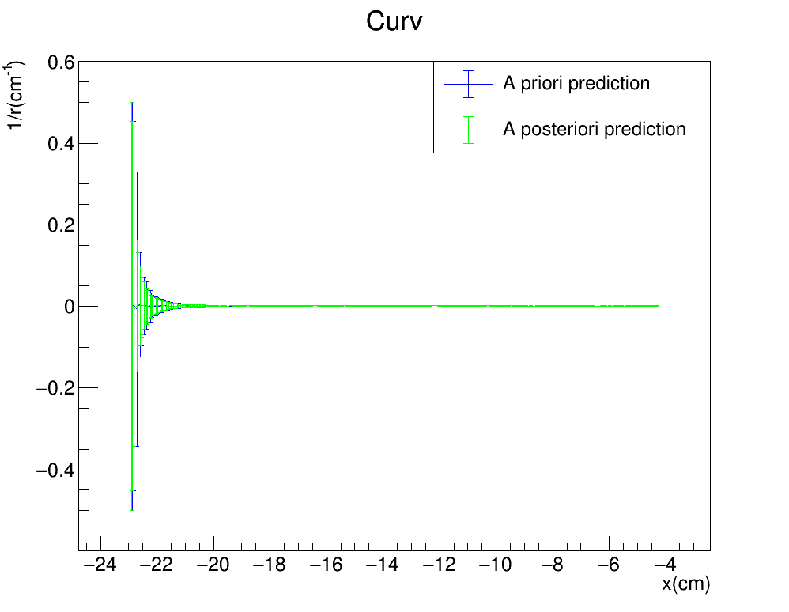
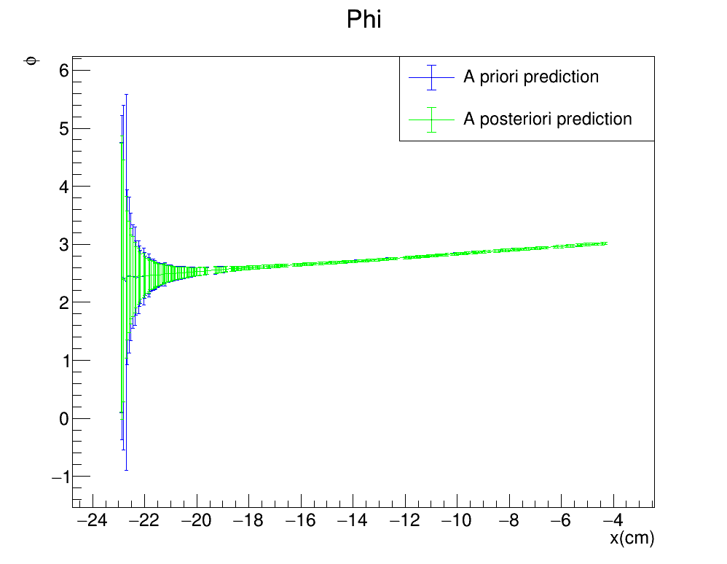
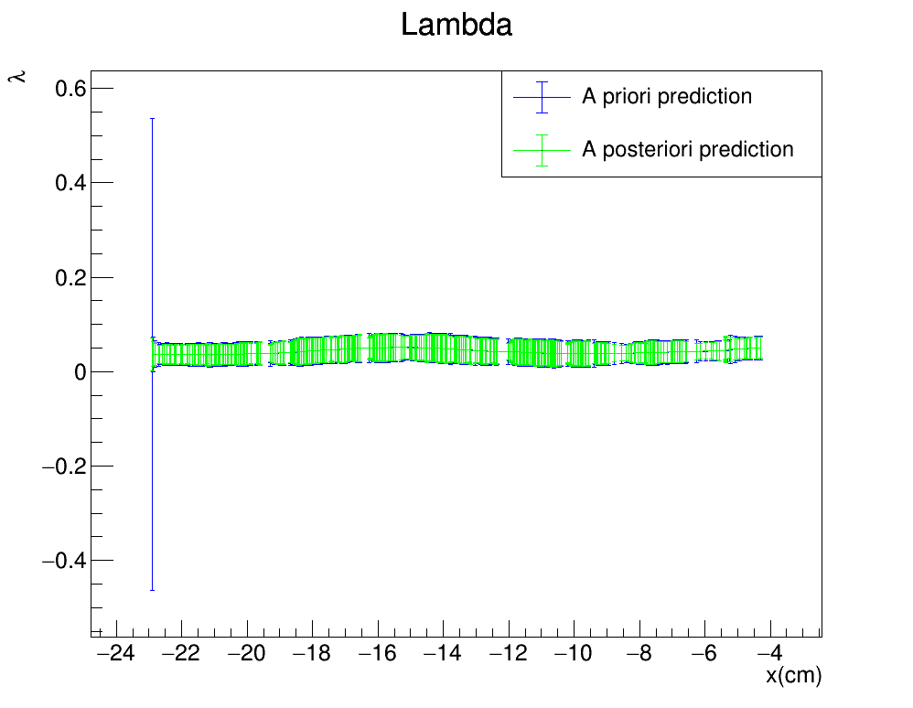
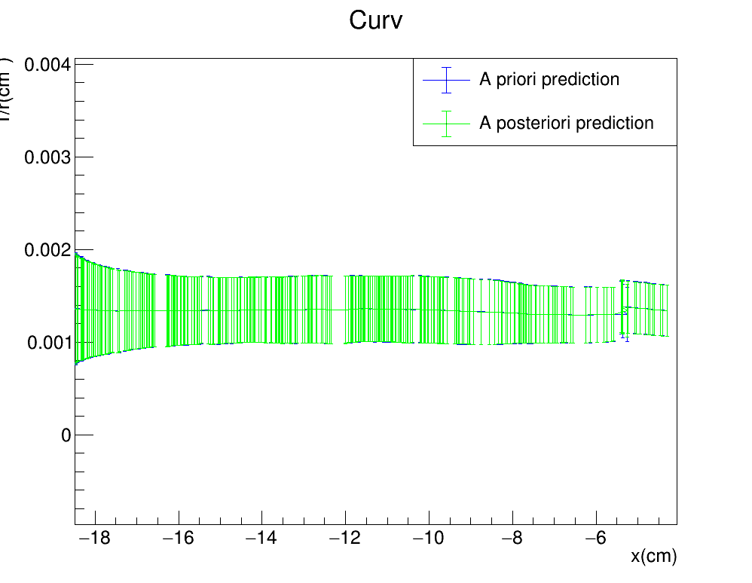
KALMAN FILTER PERFORMANCE
Plots describing the evolution of the estimate of the non measured quantities $(\frac{1}{r},φ,λ)$ as a function of the free parameter $x$: FORWARD FIT
FITTER PROPAGATION DIRECTION
19

Slide 20
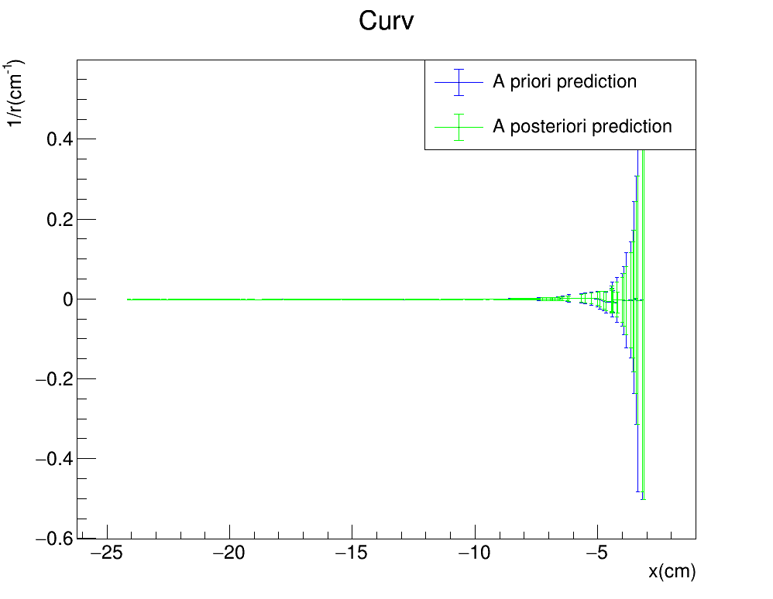
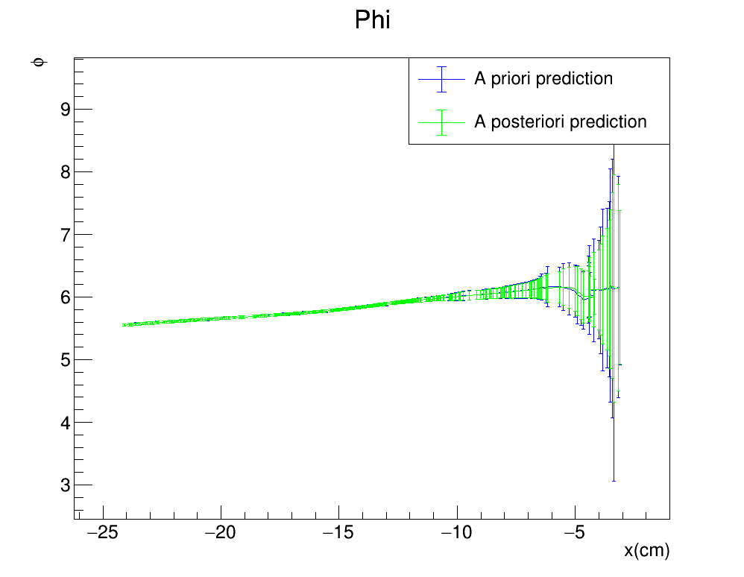
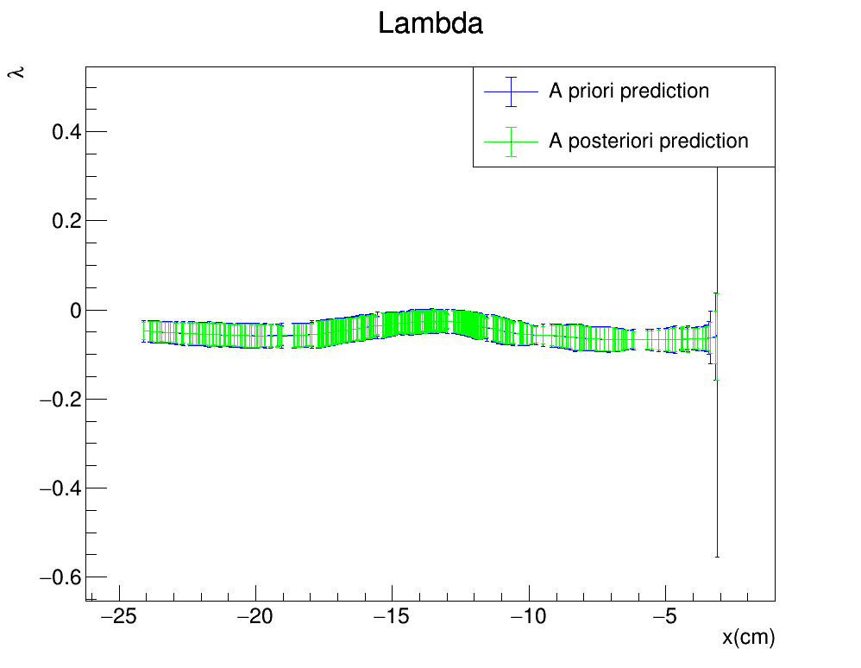
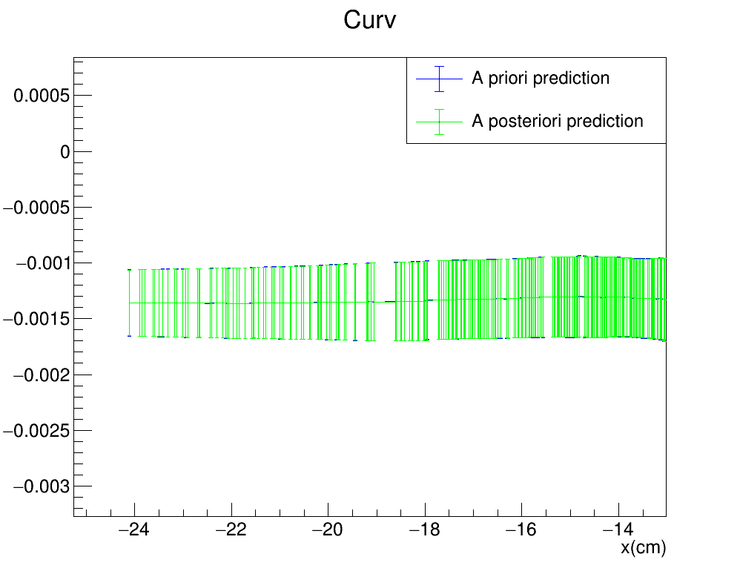
KALMAN FILTER PERFORMANCE
Plots describing the evolution of the estimate of the non measured quantities $(\frac{1}{r},φ,λ)$ as a function of the free parameter $x:$ BACKWARD FIT
FITTER PROPAGATION DITECTION
20

Slide 21
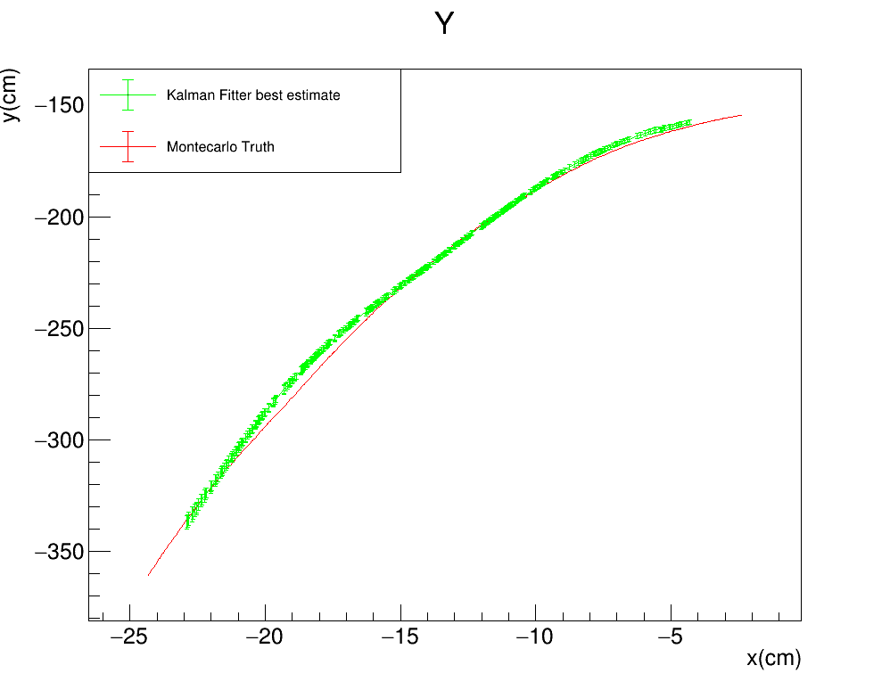
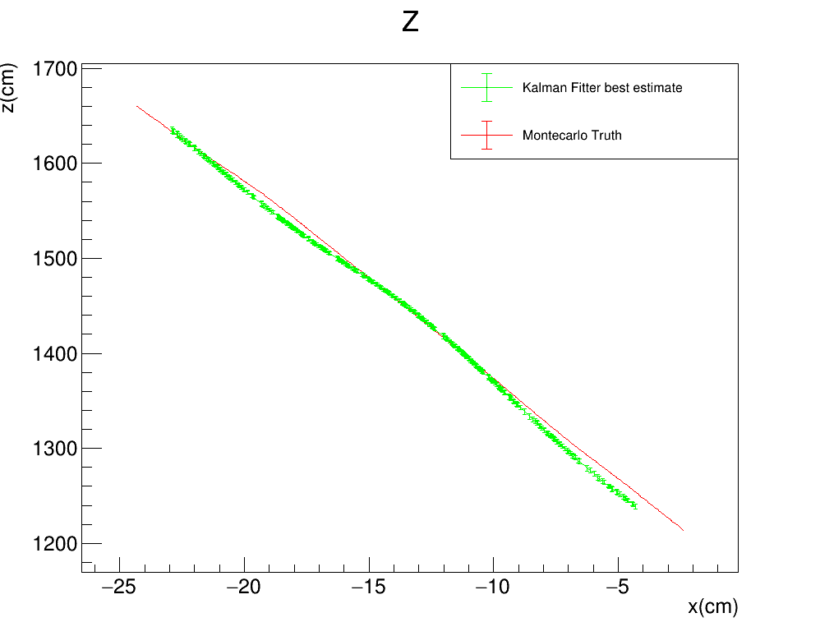
KALMAN FILTER PERFORMANCE
Plots comparing the best estimate from the Kalman fitter algorithm for the measured quantities $(y,z)$ as a function of the free parameter $x$ with the MC Truth values: FORWARD FIT
FITTER PROPAGATION DIRECTION

Slide 22
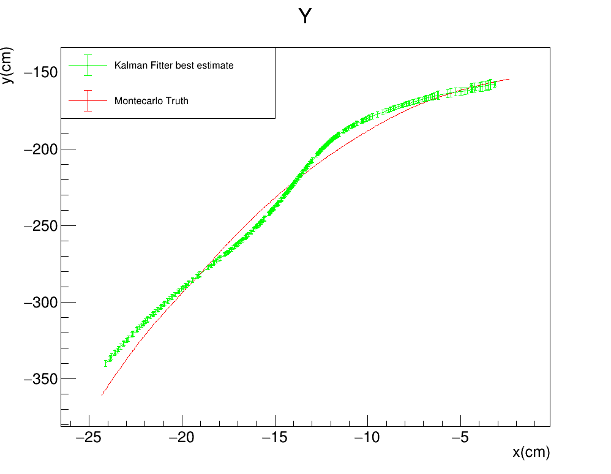
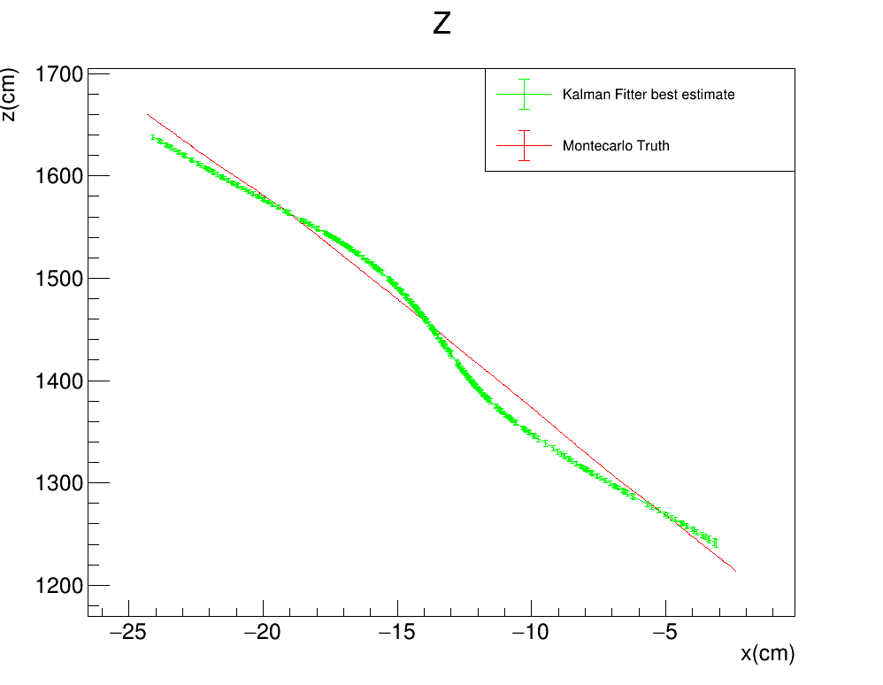
KALMAN FILTER PERFORMANCE
Plots comparing the best estimate from the Kalman fitter algorithm for the measured quantities $(y,z)$ as a function of the free parameter $x$ with the MC Truth values: BACKWARD FIT
FITTER PROPAGATION DIRECTION

Slide 23
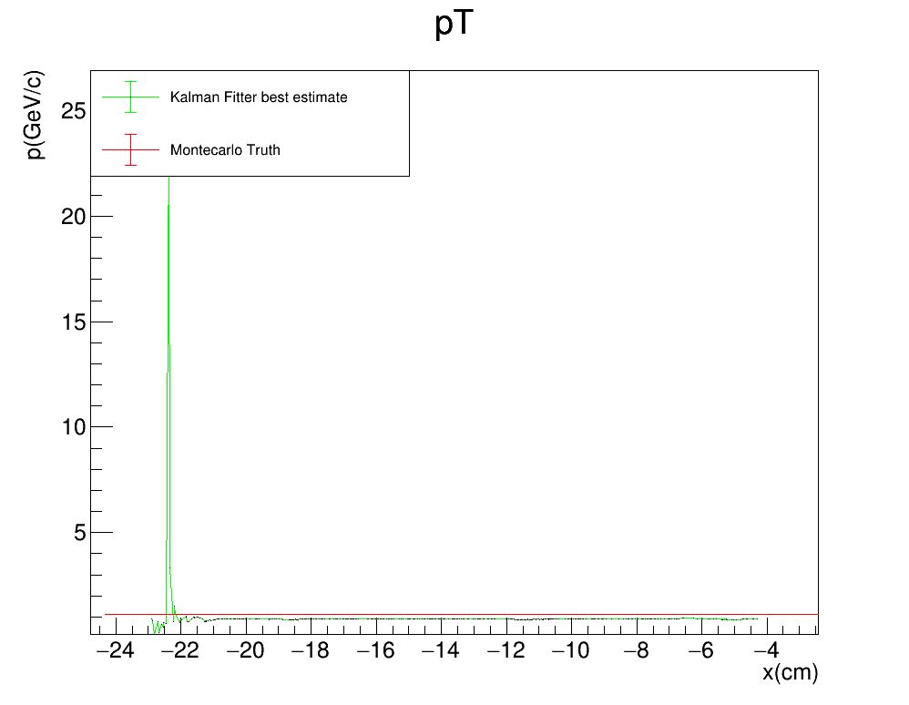
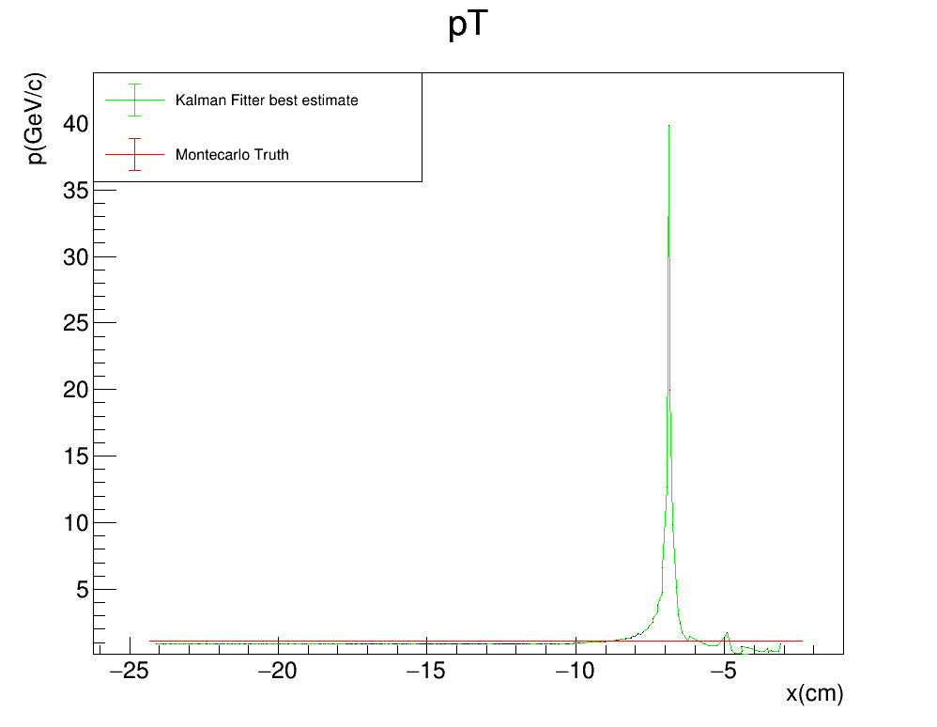
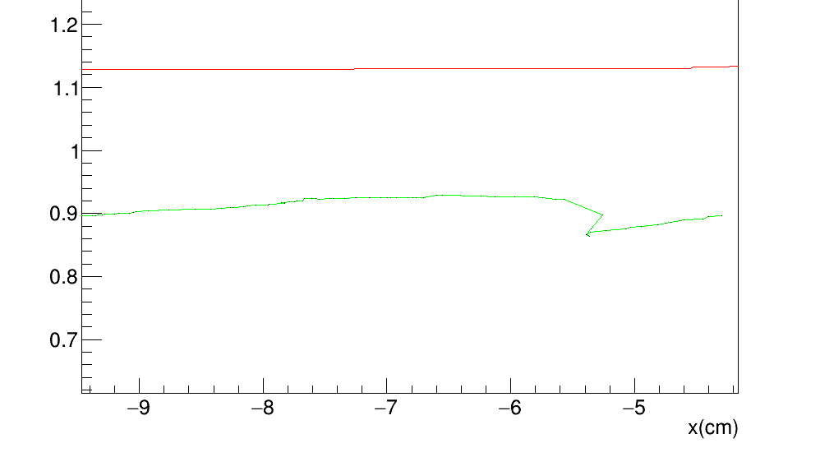
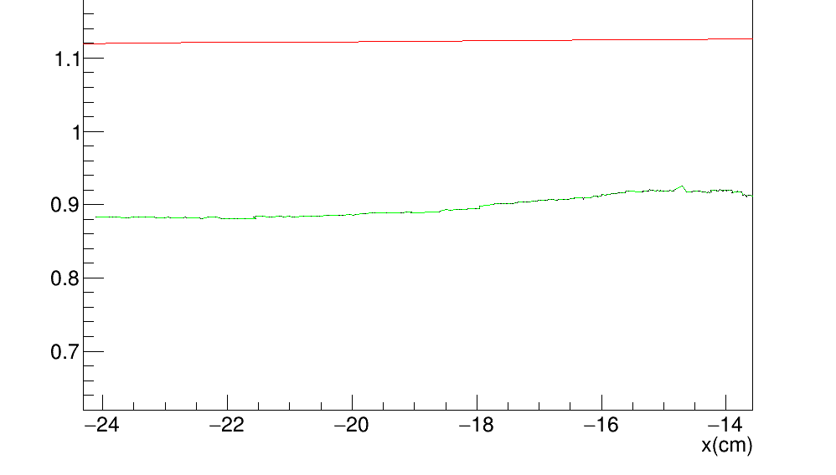
KALMAN FILTER PERFORMANCE
Plots comparing the reconstructed tansverse momentum $p_{T}$ from the Kalman fitter algorithm to the MC truth as a function of the free parameter $x$
FORWARD FIT
BACKWARD FIT

Slide 24
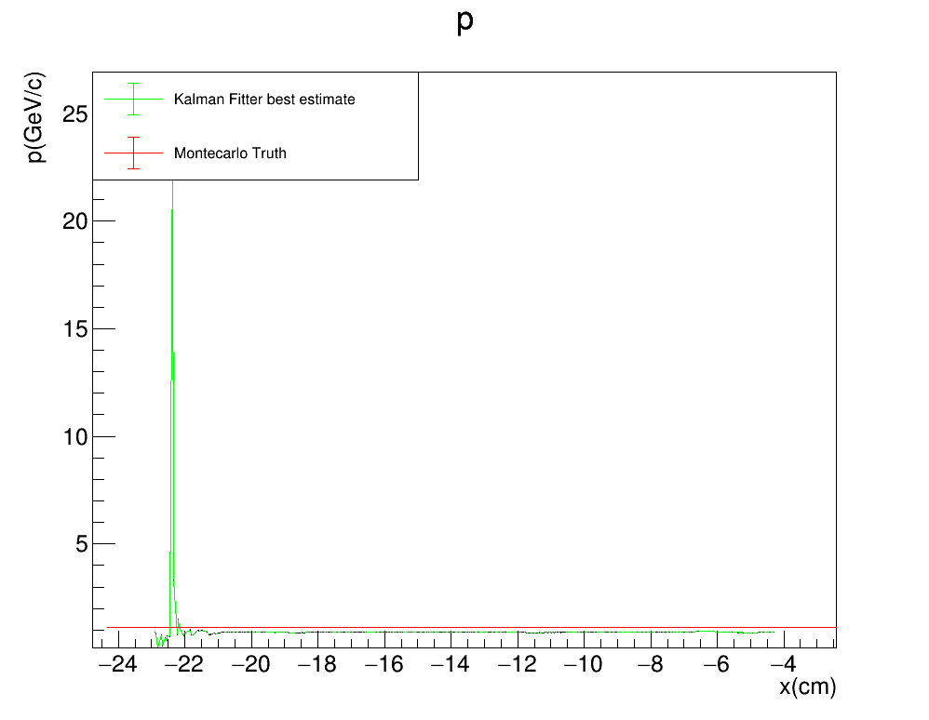

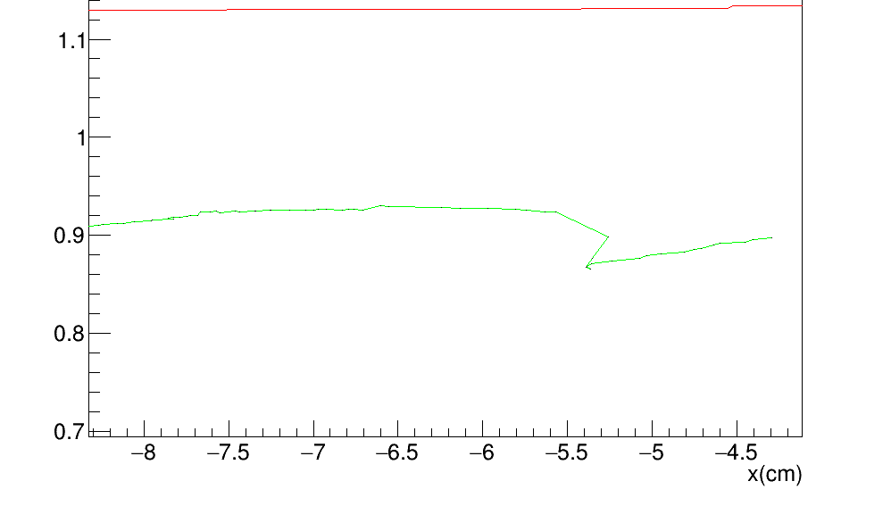
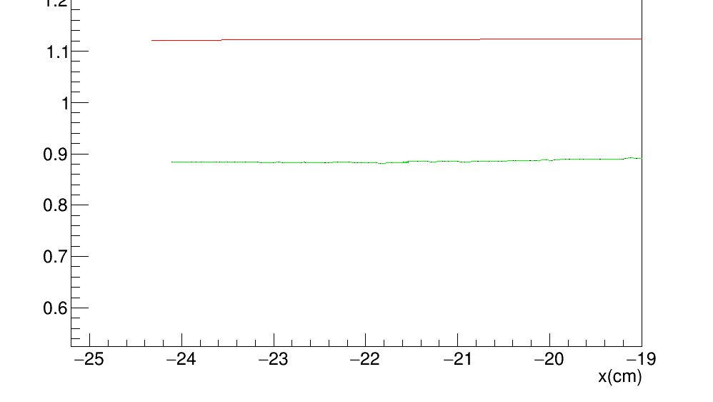
KALMAN FILTER PERFORMANCE
Plots comparing the reconstructed total momentum p from the Kalman fitter algorithm to the MC truth as a function of the free parameter $x$
FORWARD FIT
BACKWARD FIT

Slide 25
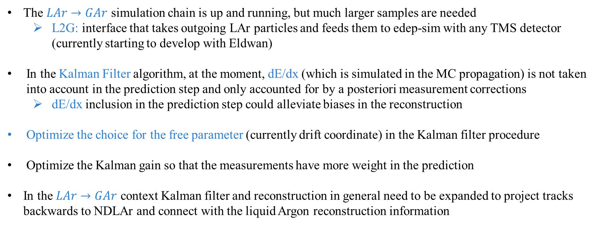
SUMMARY AND FUTURE STEPS
The $LAr→GAr$ simulation chain is up and running, but much larger samples are needed
L2G: interface that takes outgoing LAr particles and feeds them to edep-sim with any TMS detector (currently starting to develop with Eldwan)
In the Kalman Filter algorithm, at the moment, dE/dx (which is simulated in the MC propagation) is not taken into account in the prediction step and only accounted for by a posteriori measurement corrections
dE/dx inclusion in the prediction step could alleviate biases in the reconstruction
Optimize the choice for the free parameter (currently drift coordinate) in the Kalman filter procedure
Optimize the Kalman gain so that the measurements have more weight in the prediction
In the $LAr→GAr$ context Kalman filter and reconstruction in general need to be expanded to project tracks backwards to NDLAr and connect with the liquid Argon reconstruction information

Slide 26
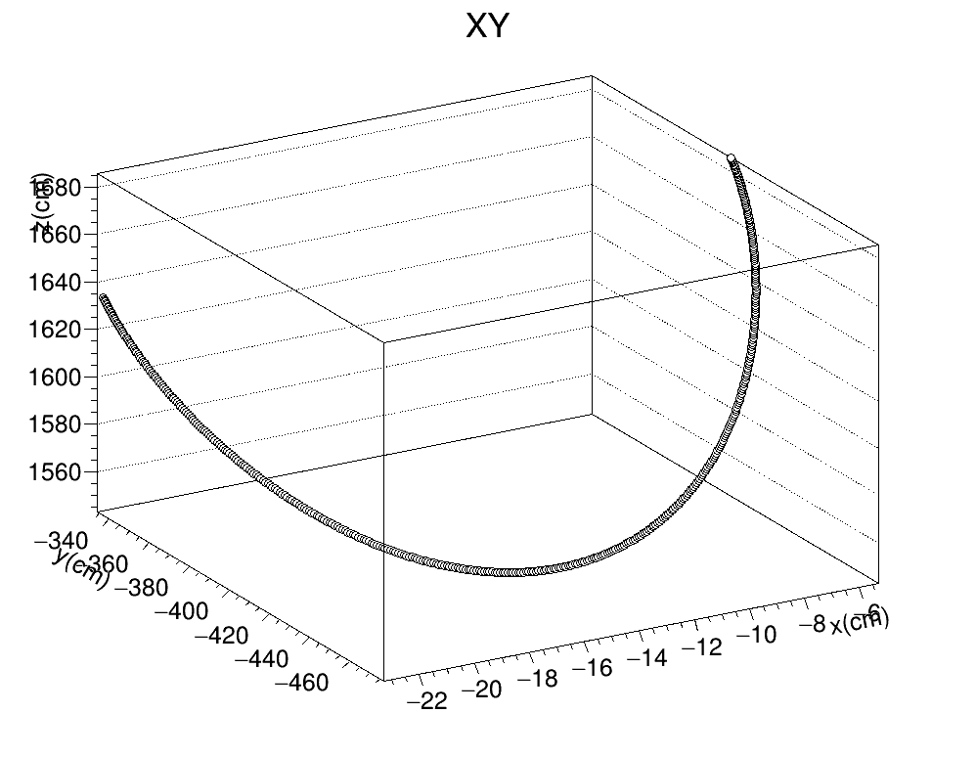
KALMAN FILTER PERFORMANCE
Applied Kalman Filter to ideal measurements following perfectly an helix with initial coordinates: $x_{i}^{T}=\begin{matrix}(y_{i} & z_{i} & 1/r_{i}\end{matrix} \begin{matrix}φ_{i} & λ_{i}\end{matrix})=\left(\begin{matrix}y_{1}^{h} & z_{1}^{h} & 0.014 cm^{−1}\end{matrix} \begin{matrix}6 rad & −0.05 rad\end{matrix}\right)$ and the free parameter $x_{i}=x_{1}^{h}$ and the step $dx=0.04 cm$

Slide 27


KALMAN FILTER PERFORMANCE
Plots describing the evolution of the estimate of the measured quantities $(y,z)$ as a function of the free parameter $x$ for the perfect helix. Note that the the fake TPC points have on the x coordinate the fake measured value, while for the estimates we use the estimated x (i.e. ${x_{k}=x}_{0}+k×dx_{k}$)
FITTER PROPAGATION DIRECTION

Slide 28


KALMAN FILTER PERFORMANCE
Plots describing the evolution of the estimate of the measured quantities $(y,z)$ as a function of the free parameter $x$ for the perfect helix. This time both the fake TPC points have on the x coordinate the fake measured value
FITTER PROPAGATION DIRECTION

Slide 29
KALMAN FILTER: PERFORMANCE evaluation
Going back to the anomalous backward fit plots, we first plot them like it was done originally (i.e. the fake TPC points have on the x coordinate the fake measured value, while for the estimates we use the estimated x )
FITTER PROPAGATION DIRECTION

Slide 30


KALMAN FILTER: PERFORMANCE evaluation
We now try using the measured value of x for everything
FITTER PROPAGATION DIRECTION

Slide 31


KALMAN FILTER PERFORMANCE
Reset Toy MonteCarlo to have smeared helix points: same initial coordinates: $x_{i}^{T}=\begin{matrix}(y_{i} & z_{i} & 1/r_{i}\end{matrix} \begin{matrix}φ_{i} & λ_{i}\end{matrix})=\left(\begin{matrix}y_{1}^{h} & z_{1}^{h} & 0.014 cm^{−1}\end{matrix} \begin{matrix}6 rad & −0.05 rad\end{matrix}\right)$
The initial free parameter is $x_{i}=x_{1}^{h}$ with step $dx_{k}=Gauss(0.04cm,0.01cm)$
After being evaluated for the current $x_{k}$ as if we had a perfect helix, the $y_{k}$ and $z_{k}$ are smeared with a Gauss distibution: $Gauss\left(y_{k},4cm\right)$
The error matrix $R$ is coherent with the smearing: $R=\left(\begin{matrix}σ_{yz}^{2} & 0 \\ 0 & σ_{yz}^{2}\end{matrix}\right)=\left(\begin{matrix}16{cm}^{2} & 0 \\ 0 & 16{cm}^{2}\end{matrix}\right)$

Slide 32


KALMAN FILTER PERFORMANCE
Plots describing the evolution of the estimate of the measured quantities $(y,z)$ as a function of the free parameter $x$ for the perfect helix. Note that the the fake TPC points have on the x coordinate the fake measured value, while for the estimates we use the estimated x (i.e. ${x_{k}=x}_{0}+k×dx_{k}$)
FITTER PROPAGATION DIRECTION

Slide 33


KALMAN FILTER PERFORMANCE
Plots describing the evolution of the estimate of the measured quantities $(y,z)$ as a function of the free parameter $x$ for the perfect helix. This time both the fake TPC points have on the x coordinate the fake measured value
FITTER PROPAGATION DIRECTION

Slide 34



UNDERSTANDING STEP DEtermination
The step width is determined for each algorithm step, so that it minimizes the distance between the current measurement and the a priori prediction:
$σ_{x}=1cm$ and $σ_{yz}=2cm$ are arbitrary values, which do not coincide with the TPC values in the R matrix
$$Δ={\left[\frac{\left(x_{k}^{h}−{\hat{x}}_{k}^{−}\right)}{σ_{x}}\right]}^{2}+{\left[\frac{\left(y_{k}^{h}−{\hat{y}}_{k}^{−}\right)}{σ_{yz}}\right]}^{2}+{\left[\frac{\left(z_{k}^{h}−{\hat{z}}_{k}^{−}\right)}{σ_{yz}}\right]}^{2}$$
The $dx_{k}$ update formula can be devided into two parts: one that depends on the evolution of the $x$ free parameter, and one on the measured quantities $y$ and $z$
$$dx_{k}=\frac{\frac{\cot{{\hat{λ}}_{k−1}^{+}}}{σ_{yz}^{2}}\left(\left(y_{k}^{h}−{\hat{y}}_{k−1}^{+}\right)\sin{{\hat{φ}}_{k−1}^{+}+}\left(z_{k}^{h}−{\hat{z}}_{k−1}^{+}\right)\cos{{\hat{φ}}_{k−1}^{+}}\right)}{{\cot^{2}{{\hat{λ}}_{k−1}^{+}}}/{σ_{yz}^{2}}+1/{σ_{x}^{2}}}+\frac{\frac{\left(x_{k}^{h}−{\hat{x}}_{k−1}^{+}\right)}{σ_{x}^{2}}}{{\cot^{2}{{\hat{λ}}_{k−1}^{+}}}/{σ_{yz}^{2}}+1/{σ_{x}^{2}}}=dx_{yz}+dx_{x}$$

Slide 35

UNDERSTANDING STEP DEtermination
The values of $σ_{x}$ and $σ_{yz}$ determine how much the update is influenced by the measured values of $x$ or of $y$ and $z$ respectivelly
With the current sigma values $dx_{yz}$ completely dominates, being often 2 or 3 orders of magnitude larger than $dx_{x}$: this gives us fairly accurate predictions for $y$ and $z$, but completely wrong ones for $x$, becuase the fit can never recover from a bad initial estimate for the free parameter
FITTER PROPAGATION DIRECTION

Slide 36


UNDERSTANDING STEP DEtermination
In order for the x parameter to have more weight in the update of $dx_{k}$, changed the value of $σ_{yz}$ from 1cm to 4cm
The fit initially concentrates on fixing the $x$ prediction until that becomes accurate, and then it focuses on yz, reaching similar levels of precision by the end
FITTER PROPAGATION DIRECTION

Slide 37



UNDERSTANDING STEP DEtermination
Reapplying the fit with the new $σ_{yz}=4cm$ we see that the 3D predictions are more in line with the Montecarlo truth, past the first few steps
FITTER PROPAGATION DIRECTION
$$σ_{yz}=2cm$$
$$σ_{yz}=4cm$$

Slide 38


UNDERSTANDING STEP DEtermination
Reapplying the fit with the new $σ_{yz}=4cm$ we see that the 3D predictions are more in line with the Montecarlo truth, past the first few steps
FITTER PROPAGATION DIRECTION
$$σ_{yz}=2cm$$
$$σ_{yz}=4cm$$

Slide 39


UNDERSTANDING STEP DEtermination
The momentum reconstruction performance remains roughly the same
BACKWARD FIT

